Slide 1
Modeling of the Greenland glacial isostatic adjustment in response to projected ice mass loss in the coming centuries
By: Mila Lubeck
Project Mentor: Dr. Christopher Harig

Slide 2
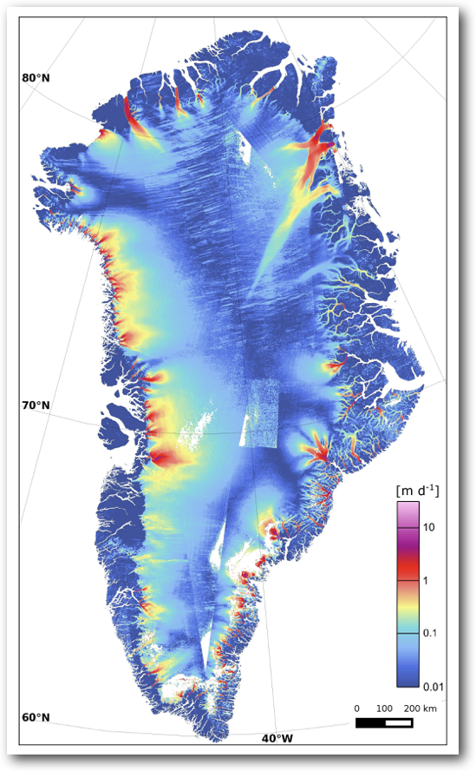
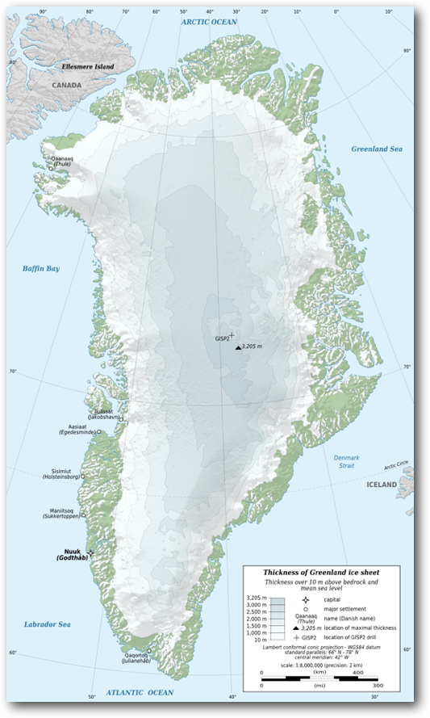
Greenland
Since 2003 the Southeastern and Northwestern Greenland Ice Sheet (GIS) has experienced significant ice mass loss

Slide 3
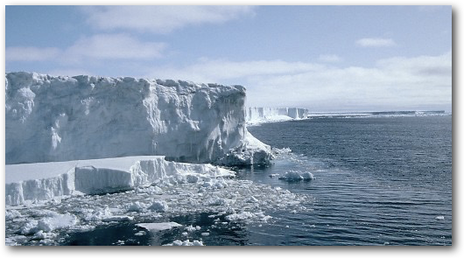
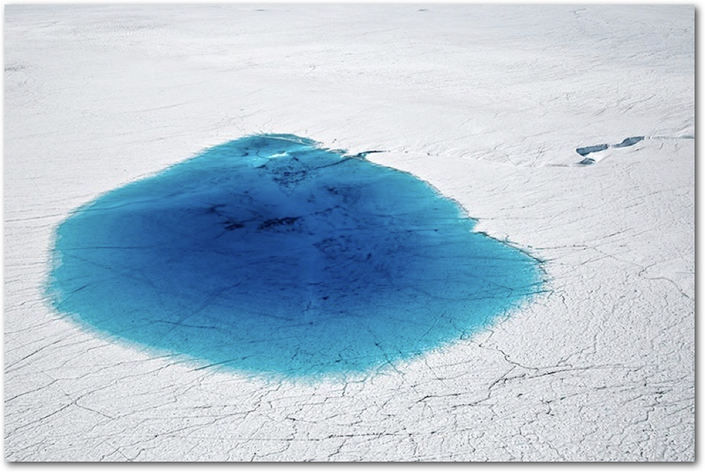
Ice Melt Processes
Calving
Melting

Slide 4
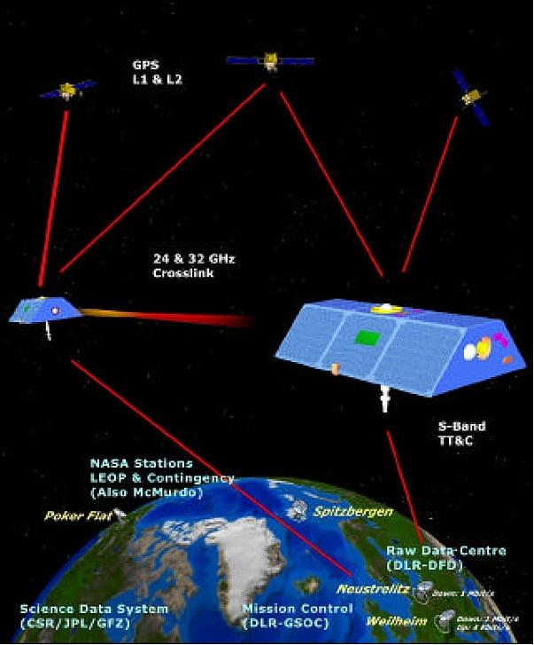
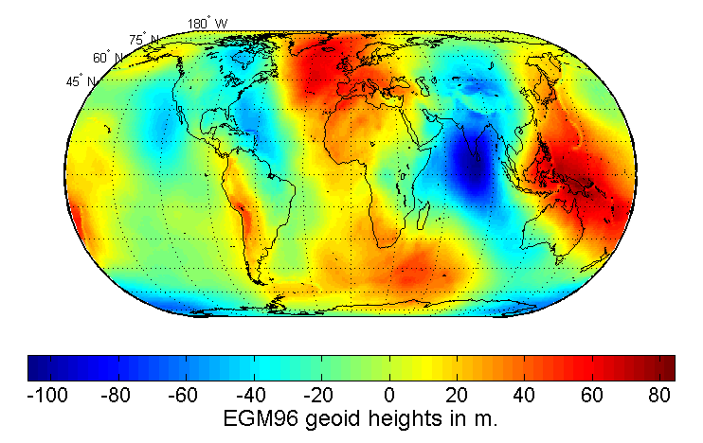
How to Measure Ice Mass Loss
The Gravity Recovery and Climate Experiment (GRACE) uses gravimetry to measure the time-variant gravity field
The gravity field is used to determine where ice sheets have lost mass
Greater signals from places of high gravity and vice versa
Ice mass loss can be used to measure the rate of vertical displacement of bedrock

Slide 5
Glacial Isostatic Adjustment(GIA)
Deformation of the crust due to the melting of large ice sheets.
GIA leads to:
Viscoelastic response
Sea level changes

Slide 6
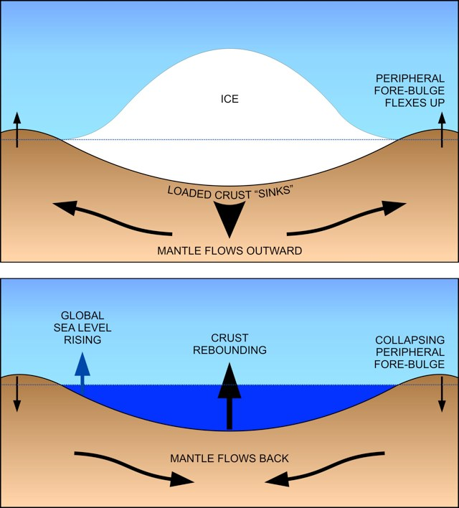
Viscoelastic Response
Since the Last Glacial Maximum (LGM) ~20,000 years ago:
Long-term viscous response and short-term elastic response to the melting of ice sheets from the LGM
Lithosphere responds elastically
Mantle responds viscously

Slide 7
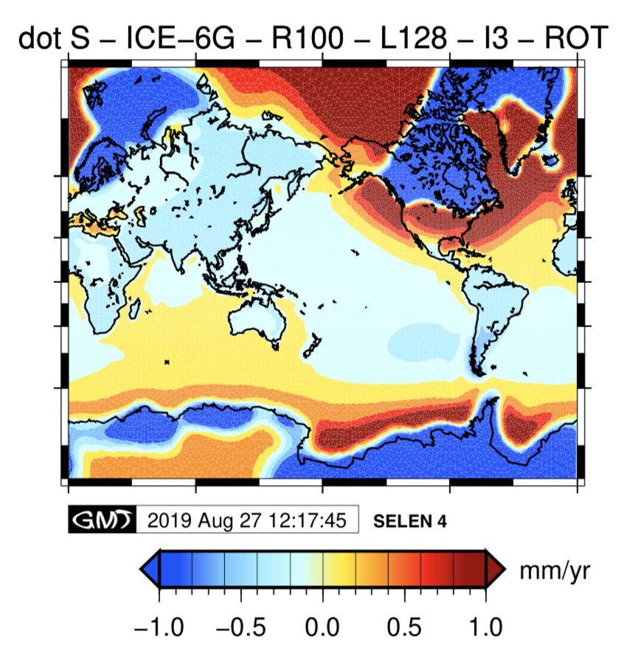
Sea Level Changes
When water is added or taken to the ocean the sea level changes
Sea level changes by GIA with land motion
The figure to the right displays sea level change due to deglaciation of the LGM
Sea level change is a complex Earth process

Slide 8
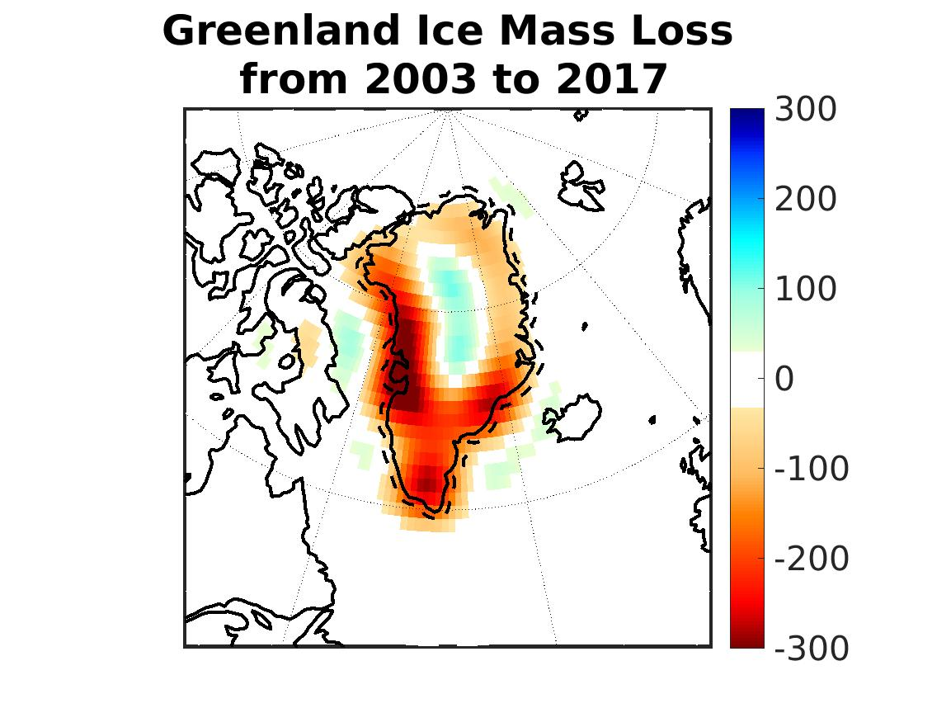
Ice Mass Loss 2003-2017
The total signal of mass change from 2003 to 2017 confirms that the majority of ice mass loss is from the Northwestern and Southeastern outlets which have lost about 200-300 cm water equivalent/ m²
Cm water equivalent / m²

Slide 9
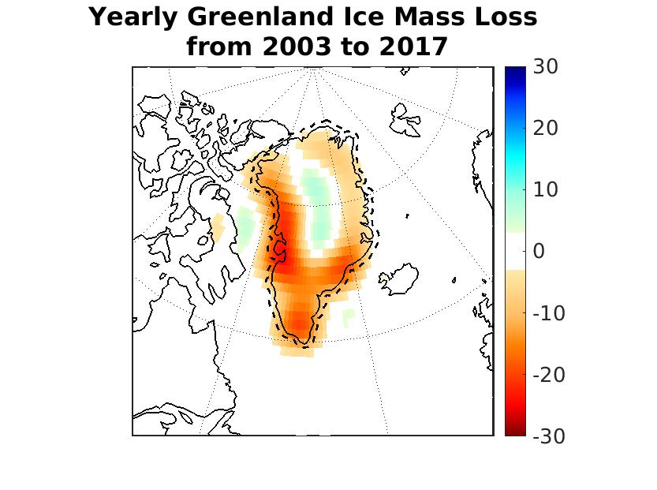
Annual average Ice Mass Loss
Yearly signal of mass change reflects the same patterns as the signal for the 14-year span with annual rates around mid 20 cm water equivalent/ m² in the Northwest and Southeast
Cm water equivalent / m²

Slide 10
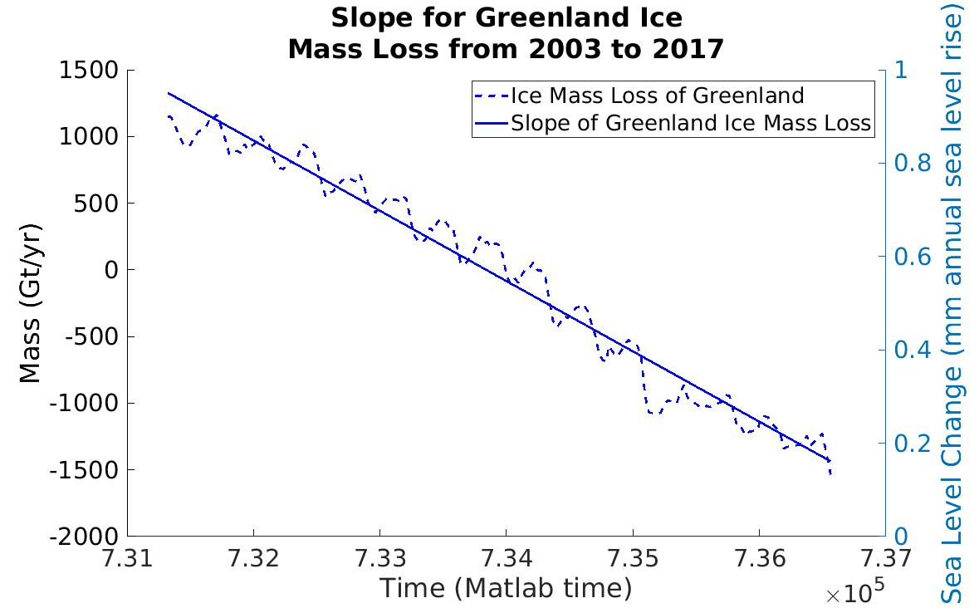
Rate of Ice Mass Loss
-192.4439 Gt/year of ice mass loss
2003 2017
(Years)

Slide 11
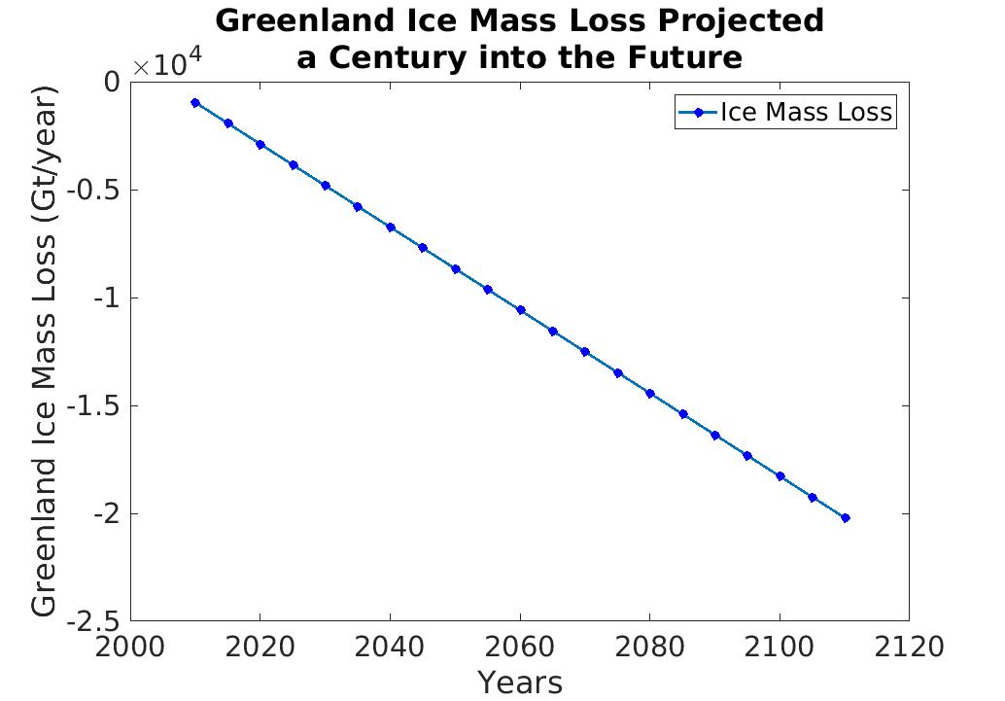
Projection of Ice Mass Loss
)
By 2110 the ice mass loss will have surpassed 20,000 Gt

Slide 12
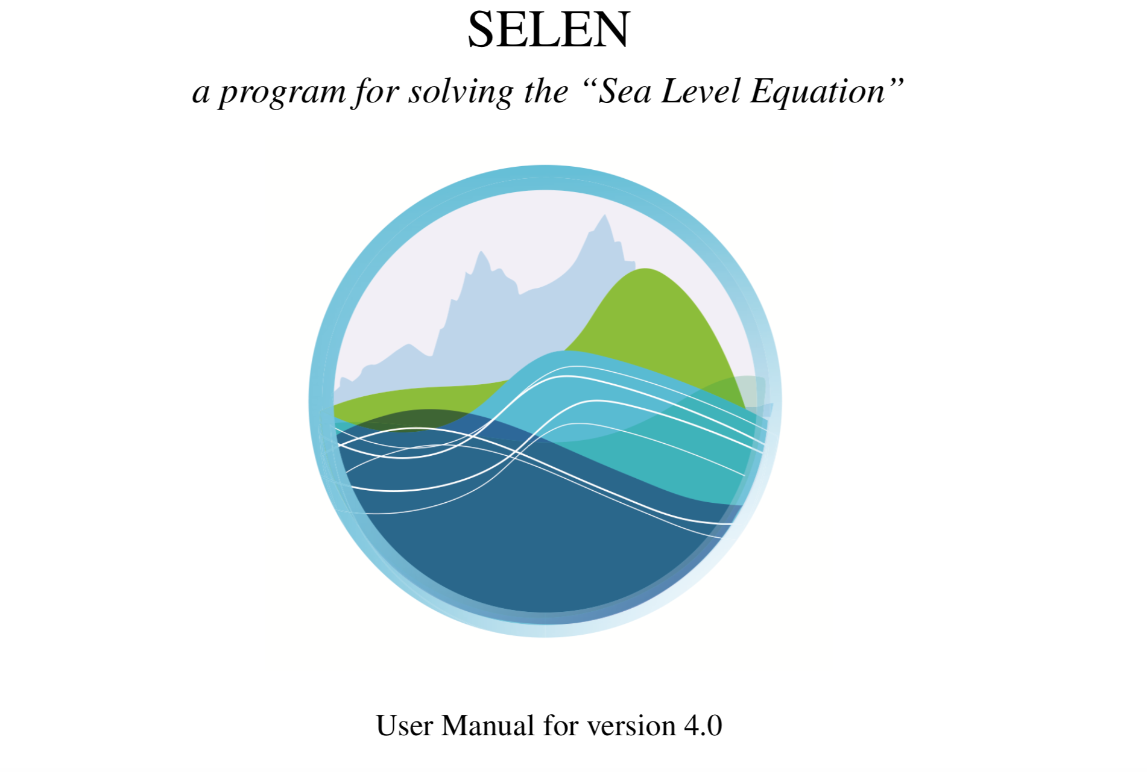
Future work
SELEN4 Fortran program (geodynamics code) will be used to project the rate of GIA 5 centuries into the future
Output will include an extrapolated rate of GIA and sea level change for several centuries
Current and future work will be included in my senior capstone

Slide 13
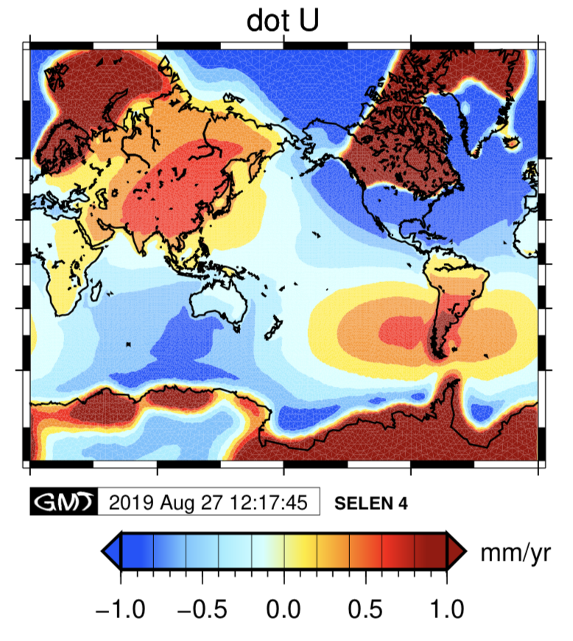
Conclusions
Greenland loses 192 Gt/year to ice melt and calving
By 2110 the total ice mass loss will surpass 20,000 Gt
The Northwest and Southeast regions will continue to experience significant ice mass loss
The GIA will continue to respond to deglaciation of Greenland

Slide 14
Acknowledgements
Thank you Dr. Harig for your continual support as a research advisor and mentor. I thank the research team including Ken, Lisa, Lavanya, and Anthony for answering my questions and being another layer of support.

Slide 15
Thank you!

